Slide 1


Jason Street
2/6/2025

Slide 2

Outline
Executive Summary
Introduction
Methodology
Results
Conclusion
Appendix

Slide 3
Executive Summary
Summary of Methodologies:
Data was collected using SpaceX API calls and web scraping.
Data was cleaned and processed through wrangling techniques.
Exploratory Data Analysis (EDA) was performed using visualization and SQL.
Interactive visual analytics was conducted using Folium and Plotly Dash.
Machine learning models (SVM, Logistic Regression, Decision Trees, KNN) were developed, tuned, and evaluated.
Summary of All Results:
The analysis identified key factors influencing successful rocket landings.
Interactive maps highlighted geographical launch patterns.
Predictive models provided insights into successful and failed launches.Summary of methodologies

Slide 4
Introduction
Project Background and Context:
The SpaceX Falcon 9 project aims to make space travel more cost-effective with reusable rockets.
Understanding launch success factors can help optimize future launches.
Problems You Want to Find Answers:
What factors contribute to a successful rocket landing?
Does payload mass or orbit type influence success rates?
What launch site has the highest success rate?

Slide 5

Section 1

Slide 6
Methodology
Executive Summary
Data collection methodology:
SpaceX API was used to retrieve launch details.
Web scraping was conducted to obtain additional launch records.
Data wrangling was performed to clean and preprocess data.
EDA and SQL were used for data insights.
Interactive dashboards were created using Folium and Plotly Dash.
Machine learning models were trained for predictive analysis.

Slide 7
Data Collection
Data Sources:
SpaceX REST API
Wikipedia (web scraping)
Preprocessed datasets for predictive analysis
Data Collection Process:
API requests retrieved launch history data.
Web scraping extracted launch records.
Data was stored in CSV format for further analysis.

Slide 8
Data Collection – SpaceX API
API request sent to SpaceX API
Response received in JSON format
JSON converted to Pandas DataFrame
Data stored in CSV
GitHub URL for Notebook:
https://github.com/JasonTaylorStreet/PublicCoursera/blob/main/jupyter-labs-spacex-data-collection-api.ipynb

Slide 9
Data Collection - Scraping
Wikipedia pages were scraped to gather additional launch data.
BeautifulSoup was used to extract table data.
Data was cleaned and formatted into structured CSV files.
GitHub URL for Notebook: https://github.com/JasonTaylorStreet/PublicCoursera/blob/main/jupyter-labs-webscraping%20(1).ipynb

Slide 10
Data Wrangling
Processing Steps:
Removing irrelevant columns.
Handling missing values.
Standardizing data formats.
Transforming categorical variables into numerical values.
GitHub URL for Notebook:
https://github.com/JasonTaylorStreet/PublicCoursera/blob/main/labs-jupyter-spacex-Data%20wrangling.ipynb

Slide 11
EDA with Data Visualization
Charts and Visualizations:
Scatter plots for Flight Number vs. Launch Site.
Bar charts for launch success rates by orbit type.
Line charts for yearly success trends.
GitHub URL for Notebook:
https://github.com/JasonTaylorStreet/PublicCoursera/blob/main/edadataviz.ipynb

Slide 12
EDA with SQL
SQL Queries Performed:
Identified unique launch sites.
Filtered data based on specific conditions (e.g., NASA launches).
Aggregated payload masses for different booster versions.
GitHub URL for Notebook:
https://github.com/JasonTaylorStreet/PublicCoursera/blob/main/jupyter-labs-eda-sql-coursera_sqllite%20(1).ipynb

Slide 13
Build an Interactive Map with Folium
Map Objects Added:
Launch Site Markers (folium.Marker) – Identify SpaceX launch sites.
Circular Zones (folium.Circle) – Show area influence (1 km radius).
Success/Failure Markers (folium.MarkerCluster) – Green for success, red for failure.
Mouse Position Tool (MousePosition) – Displays real-time coordinates.
Distance Measurement Lines (folium.PolyLine) – Connect sites to coastlines, highways, cities.
Purpose:
Visualize launch site distribution.
Analyze proximity to infrastructure.
Identify geographic patterns in success rates.
GitHub URL for Notebook:
https://github.com/JasonTaylorStreet/PublicCoursera/blob/main/lab_jupyter_launch_site_location.ipynb

Slide 14
Build a Dashboard with Plotly Dash
Dashboard Components Added:
Dropdown Menu (dcc.Dropdown) – Select launch sites.
Success Rate Pie Chart (dcc.Graph) – Displays launch success distribution.
Payload Slider (dcc.RangeSlider) – Filters payload mass range.
Scatter Plot (dcc.Graph) – Shows payload vs. launch success with booster version color-coded.
Purpose:
Allow interactive exploration of launch success rates.
Identify key factors influencing successful landings.
Analyze payload impact on mission success.
GitHub URL for Notebook:
https://github.com/JasonTaylorStreet/PublicCoursera/blob/main/spacex_dash_app.py

Slide 15
Predictive Analysis (Classification)
Data Preparation
Standardized features using StandardScaler
Split data into training (80%) and testing (20%) sets
Model Training & Hyperparameter Tuning
Used GridSearchCV to find the best parameters for:
Logistic Regression (C, penalty, solver)
Support Vector Machine (SVM) (kernel, C, gamma)
Decision Tree (criterion, max_depth, min_samples_split)
K-Nearest Neighbors (KNN) (n_neighbors, algorithm, p)
Model Evaluation
Compared models based on accuracy scores on test data
Used confusion matrices to analyze misclassifications
Best Performing Model
The model with highest test accuracy was selected
If multiple models had the same accuracy, interpretability & computation efficiency were considered
GitHub URL for Notebook:
https://github.com/JasonTaylorStreet/PublicCoursera/blob/main/SpaceX_Machine%20Learning%20Prediction_Part_5.ipynb

Slide 16
Results
Exploratory Data Analysis Findings:
Certain launch sites had higher success rates.
Orbit type influenced landing success.
Machine Learning Findings:
SVM and Logistic Regression models performed best.
Payload mass was a key determinant of success.

Slide 17

Section 2

Slide 18
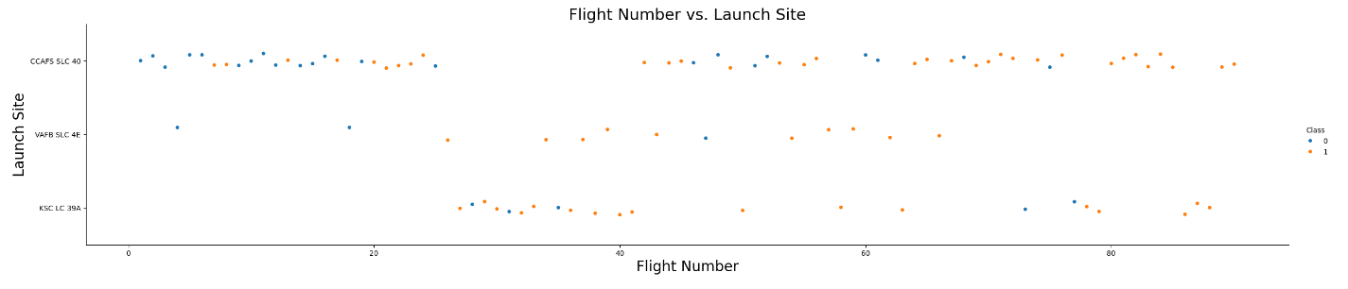
Flight Number vs. Launch Site
Most flights took place at site CCAFS SLC 40. There appears to be a range of flight numbers that did not occur at this site but rather KSC LC 39A. Further investigation required into probable causes such possible site maintenance

Slide 19
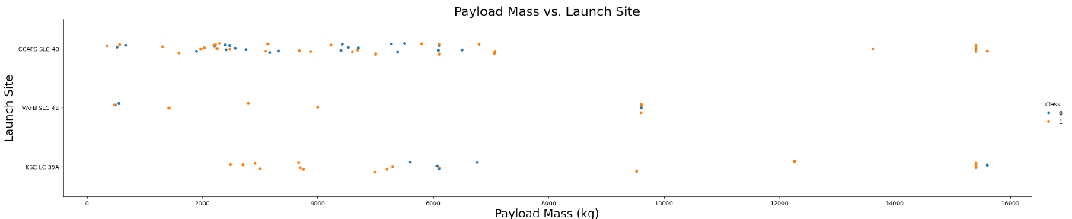
Payload vs. Launch Site
The CCAFS SLC 40 site had the most variety in payload mass which trends with the number of flights from the previous slide.

Slide 20
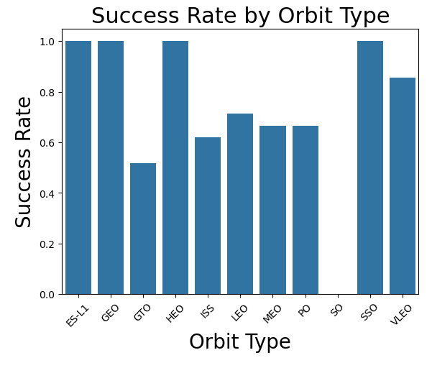
Success Rate vs. Orbit Type
The ES-L1, GEO, HEO, SSO, and VLEO orbit types had the greatest success
Next slide will provide perspective at the displayed rates. For example, GEO had only 1 flight number assigned

Slide 21
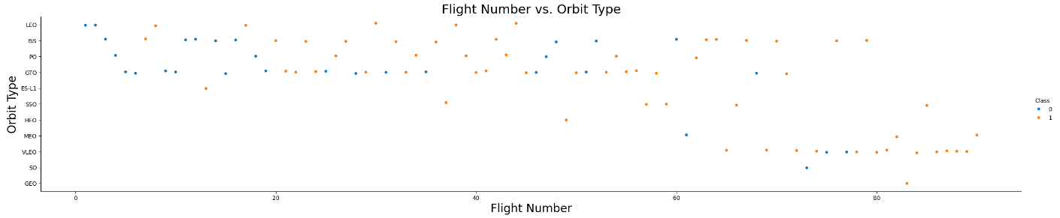
Flight Number vs. Orbit Type
The orbit types ES-L1, SSO, HEO, MEO, SO, and GEO had relatively fewer flight numbers which in which case a single failure will have a greater impact on the success rate of the previous slide.

Slide 22
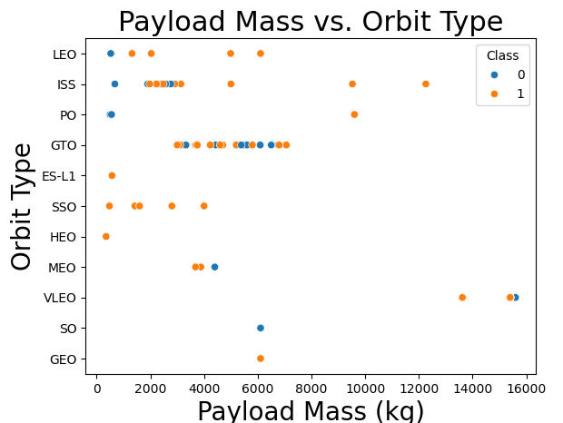
Payload vs. Orbit Type
Specific orbit types have specific ranges of payload mass with most below 8000kg (except 2 ISS, 1 PO, and 3 VLEO)

Slide 23
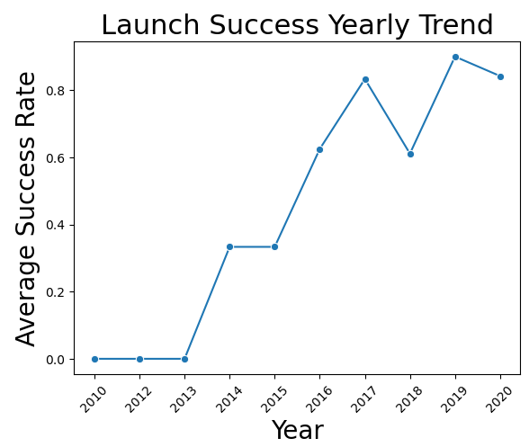
Launch Success Yearly Trend
There is a positive correlation for success as time progresses. Further investigation is required as to lowered success in 2018.

Slide 24
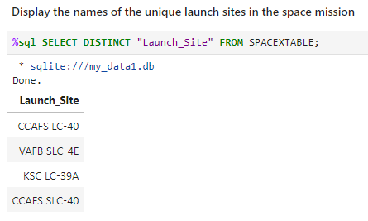
All Launch Site Names
Utilized DISTINCT to return the 4 unique launch sites.

Slide 25
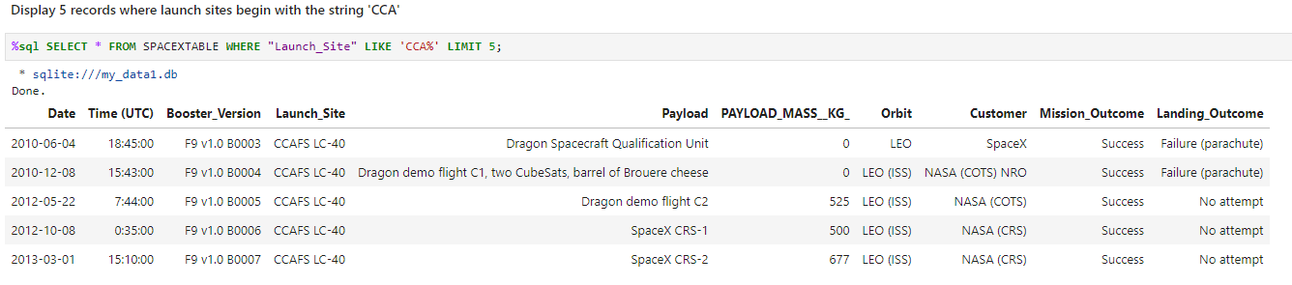
Launch Site Names Begin with 'CCA'
Utilized % as a wild card to ensure both CCAFS LC-40 and CCAFS SLC-40 were returned

Slide 26
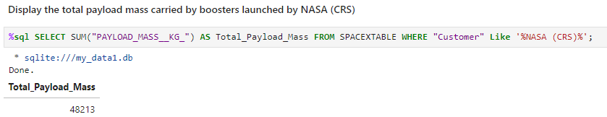
Total Payload Mass
The above is total payload mass specifically for customer NASA (CRS)

Slide 27
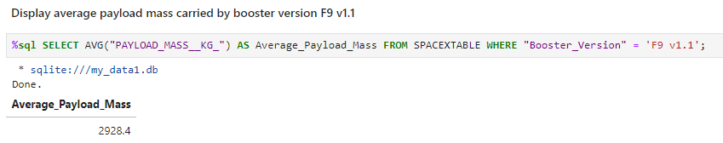
Average Payload Mass by F9 v1.1

Slide 28
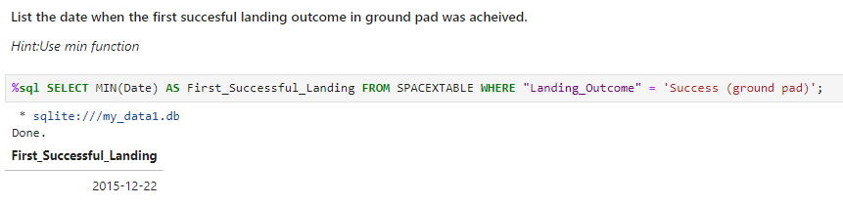
First Successful Ground Landing Date

Slide 29
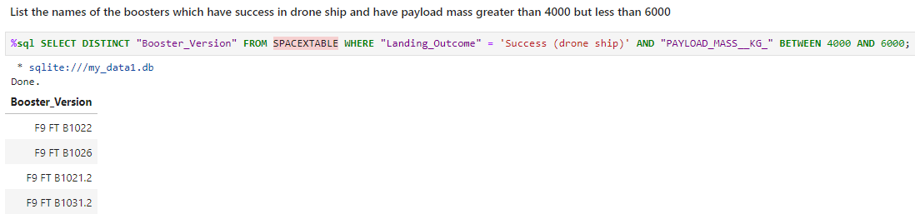
Successful Drone Ship Landing with Payload between 4000 and 6000

Slide 30
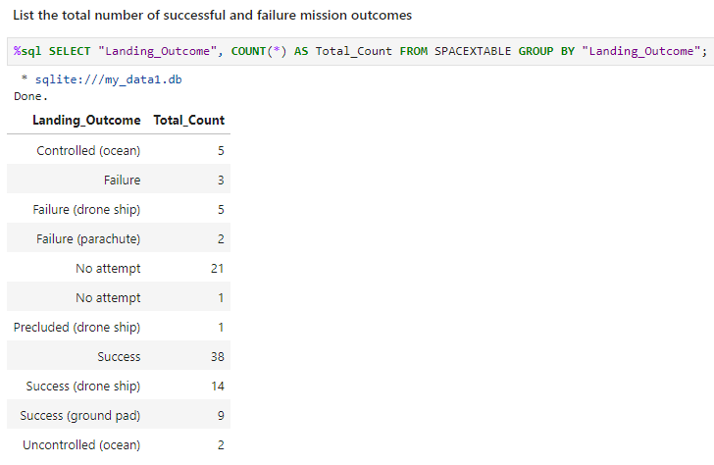
Total Number of Successful and Failure Mission Outcomes

Slide 31
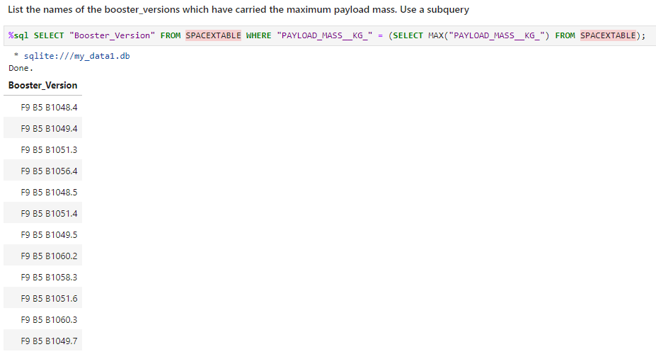
Boosters Carried Maximum Payload

Slide 32
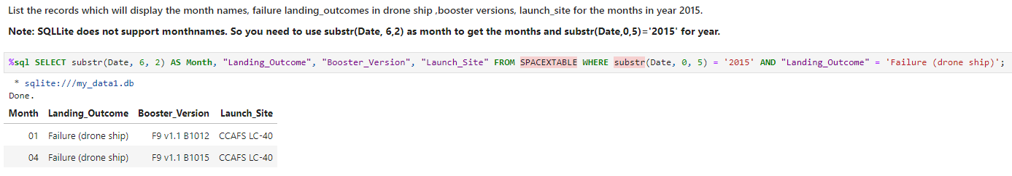
2015 Launch Records

Slide 33
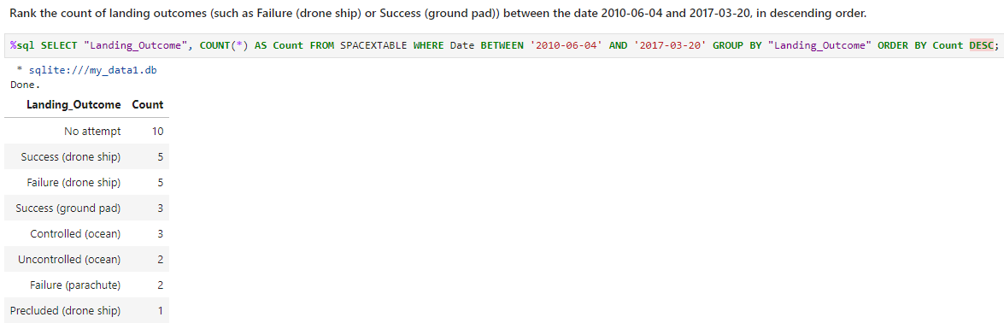
Rank Landing Outcomes Between 2010-06-04 and 2017-03-20

Slide 34

Section 3

Slide 35
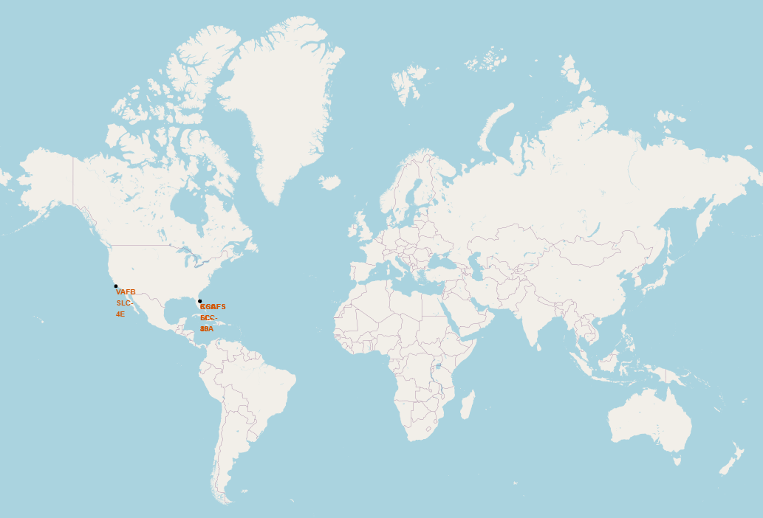
All Launch Sites – Map Marker
Launches Occurred off the coast of California, USA and Florida, USA

Slide 36
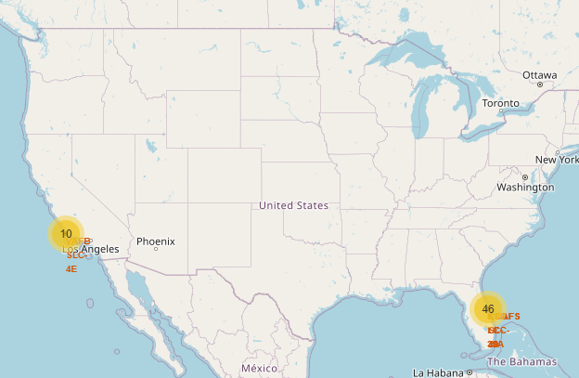
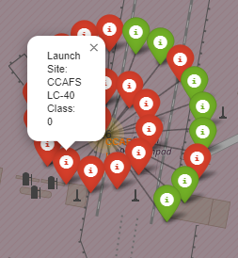
Launch Success & Failure-Detailed Cluster Map
Cluster with numbers indicate the number of launches from that location
Green specific launch marker indicates success, Red failure

Slide 37
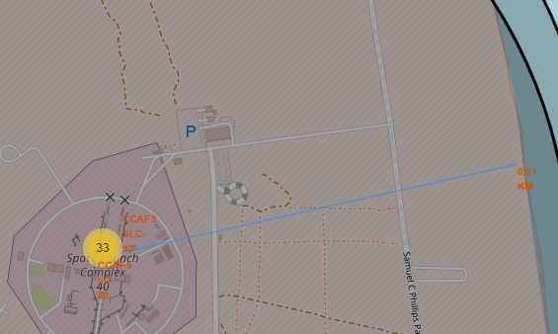
Distances Between Site and Landmarks
Map is capable for determining the distance between the selected site and desired landmark. Displayed is example of distance to coastline
In general, launch sites are located near coast lines and distance to other major landmarks is relative

Slide 38

Section 4

Slide 39
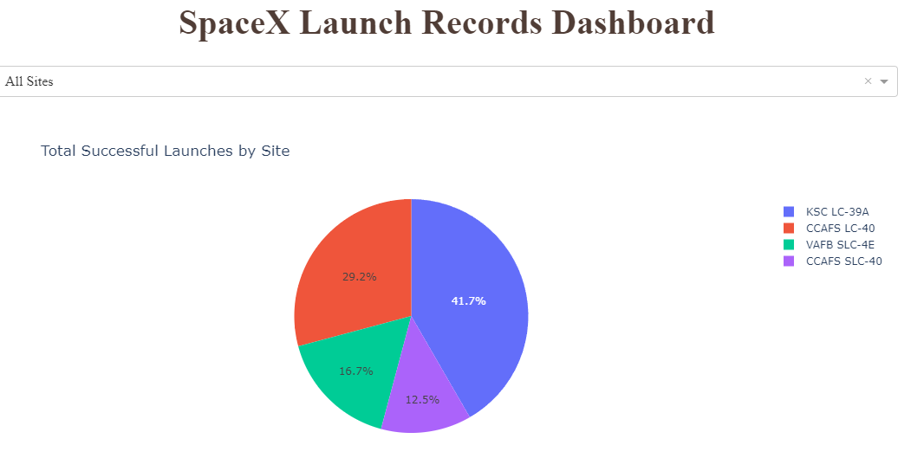
Pie chart Success Rate by Launch Site
KSC LC-39A had the most successful launches

Slide 40
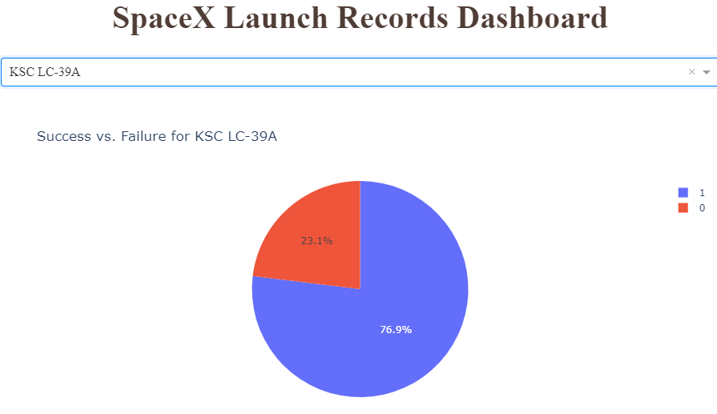
Pie chart Success Rate of the Most Successful Site
Out of the 41.7% Success Rate of all launches, the KSC LC-39A site had a success rate of 76.9% of all of this specific site’s launches

Slide 41
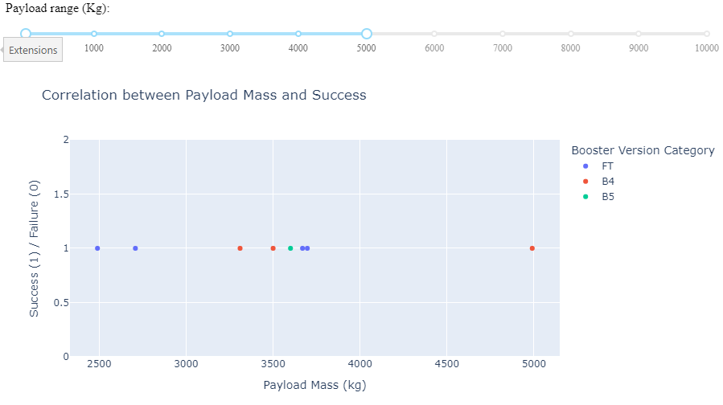
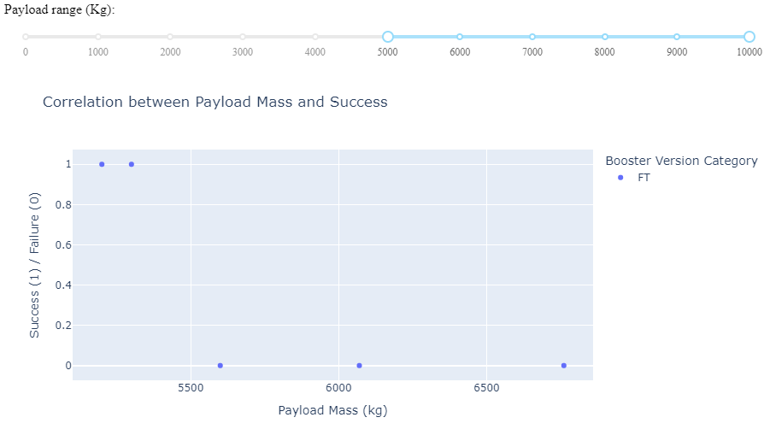
Payload Mass vs Success – scatter plot
Left is Payload Mass 0-5000kg and Right is 5000-10000kg
There were no failures until payload mass was >5500kg

Slide 42

Section 5

Slide 43
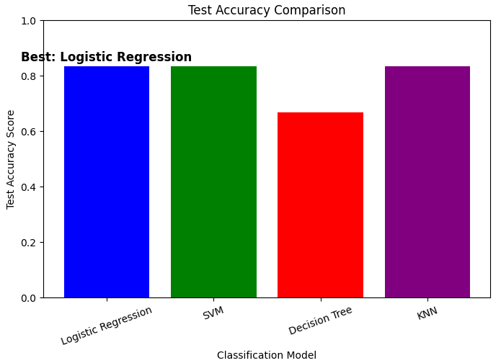
Classification Accuracy
Test Accuracy (Performance on Unseen Test Data):
Logistic Regression: 0.8333
SVM: 0.8333
Decision Tree: 0.6667
KNN: 0.8333
Cross-Validation Accuracy (Performance During Training):
Logistic Regression: 0.8464
SVM: 0.8482
Decision Tree: 0.8768
KNN: 0.8482
Best Performing Model(s) Based on Test Accuracy: ['Logistic Regression', 'SVM', 'KNN']
Highest Test Accuracy: 0.8333333333333334
Best Performing Model(s) Based on Cross-Validation Accuracy: ['Decision Tree']
Highest Cross-Validation Accuracy: 0.8767857142857143
Decision Tree indicates potential overfitting

Slide 44
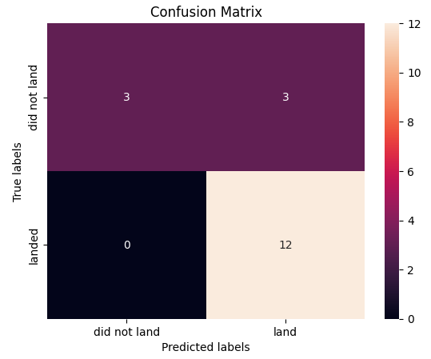
Confusion Matrix
The area of concern is the false positives .i.e., unsuccessful landing marked as successful landing by the classifier.

Slide 45
Conclusions
Launch Success Trends: KSC LC-39A had the highest success rate. Payload mass and orbit type significantly influenced outcomes. Success rates improved over time.
Machine Learning Insights:
Best test accuracy (83.3%): Logistic Regression, SVM, KNN
Highest training accuracy (87.7%): Decision Tree (potential overfitting)
Payload mass was a key success factor.
Interactive Analytics:
Folium maps revealed launch site proximity patterns.
Plotly Dash enabled dynamic success rate analysis.

Slide 46


